Slide 1

AquaPark – Norad funded project
Planning and management of aquaculture parks for sustainable development of cage farms in the Philippines
www.aqua-park.asia

Slide 2
Mariculture park management
Mooring trial
Oil spill contingency planning
Better Management practices
Socio economic survey
Economic analysis
Layout optimisation
Integrated Aquaculture

Slide 3

Mooring Trial
Mooring Scale Model
Notes:
3

Slide 4
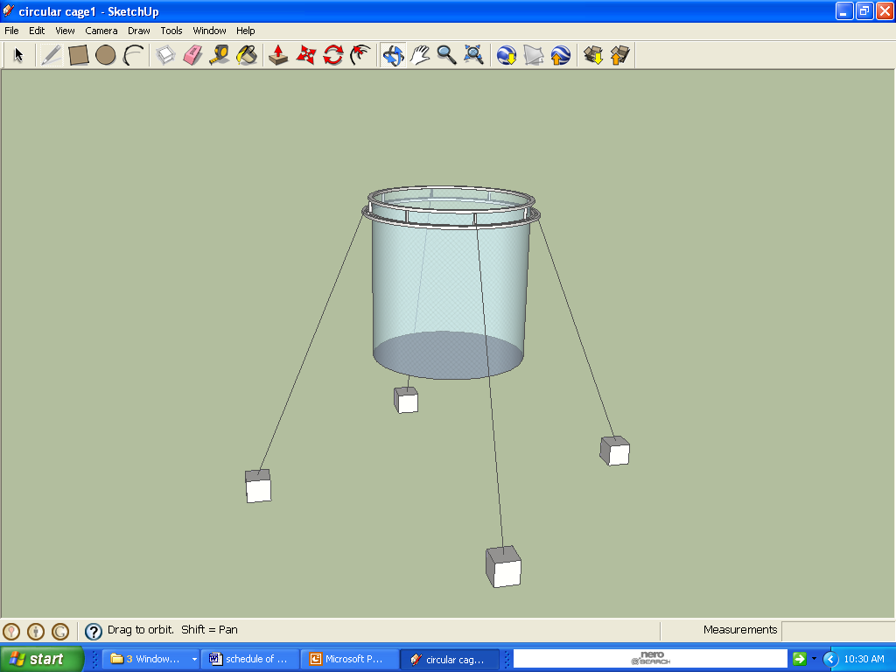
Typical cage mooring
12 m
15 – 20 m
15 m
15 m
Mooring Scale Model

Slide 5
Mooring trial - scale model
1.2 m
1.5 – 2.0 m
1.5 m
1.5 m
Mooring Scale Model

Slide 6
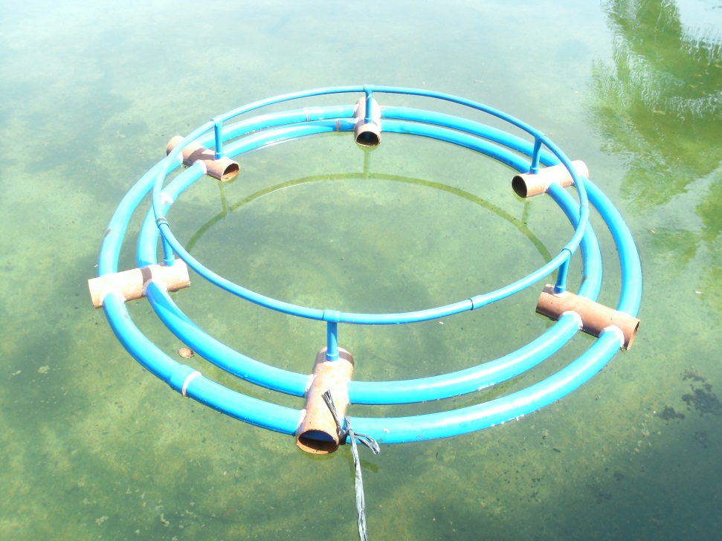
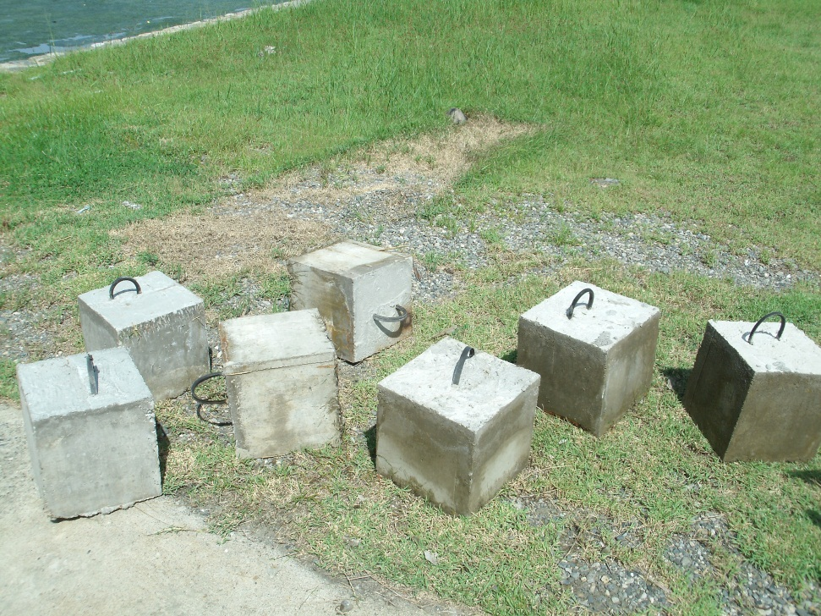
Mooring trial - scale model
Mooring Scale Model

Slide 7
Mooring trial - scale model
Measure kilos of pull needed to move the moorings
1.2 m
1.5 – 2.0 m
1.5 m
1.5 m
Mud on bottom of tank
Mooring Scale Model

Slide 8
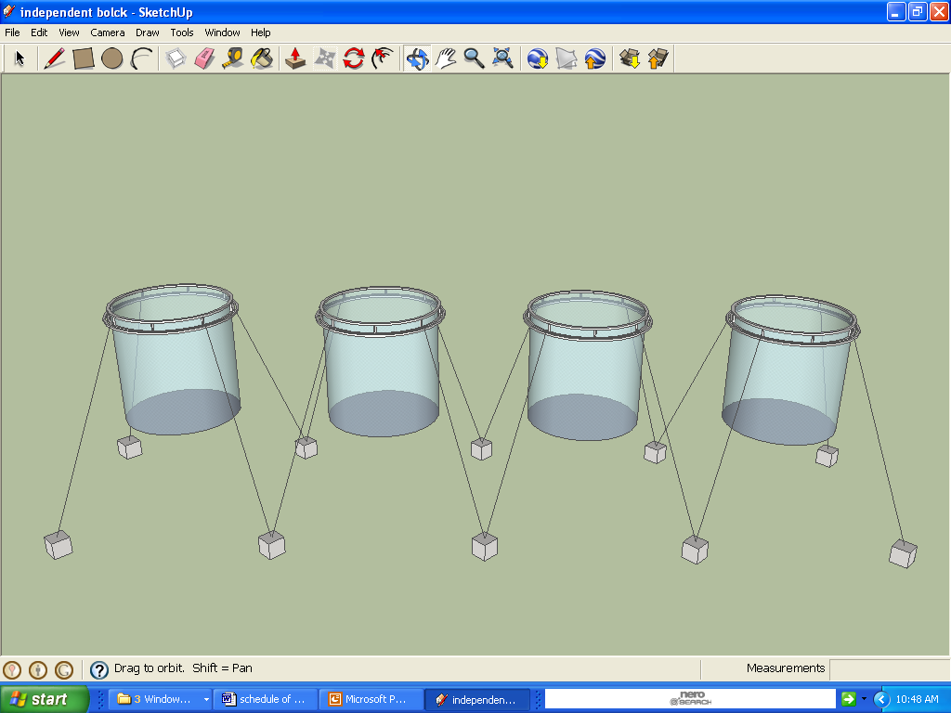
Improved Mooring System
Independent block moorings, upward lift
Mooring Scale Model

Slide 9
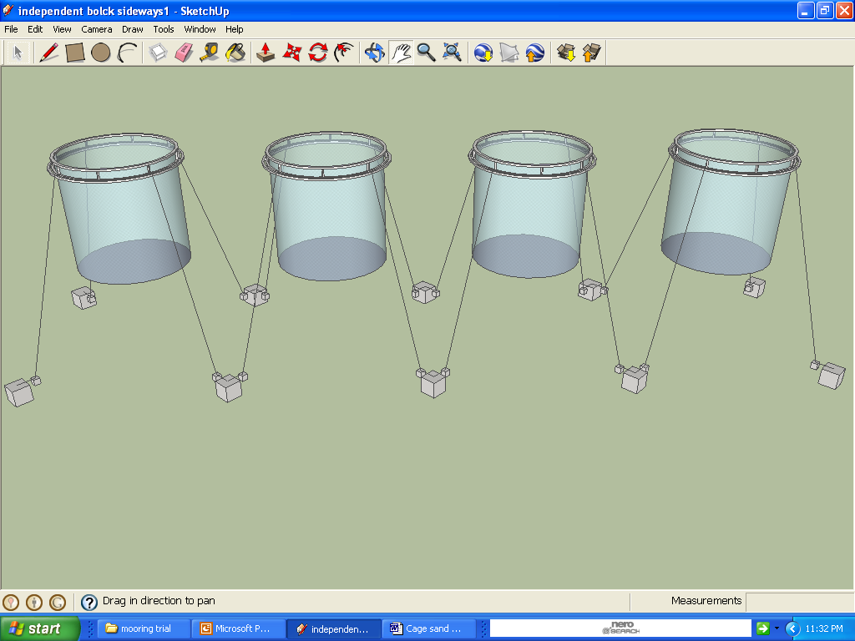
Independent block moorings, sideways lift
Improved Mooring System
Mooring Scale Model

Slide 10
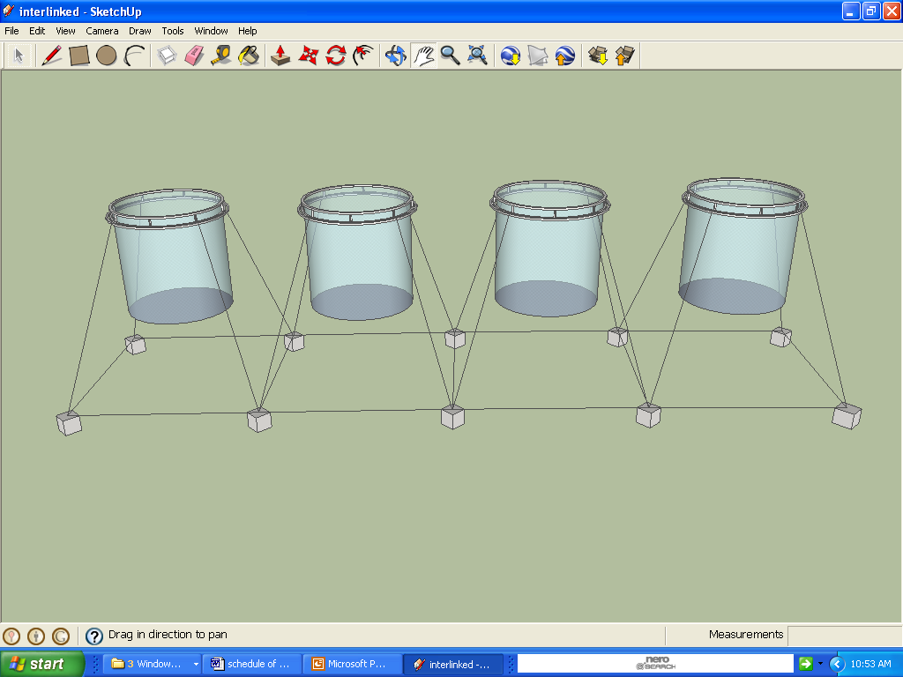
Interlinked block moorings, upward lift
Improved Mooring System
Mooring Scale Model

Slide 11
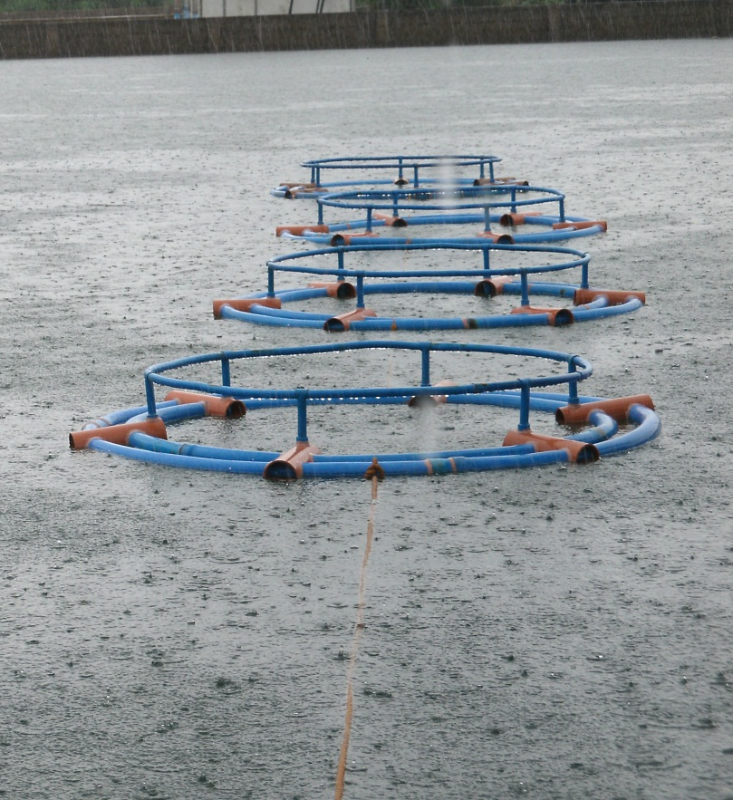
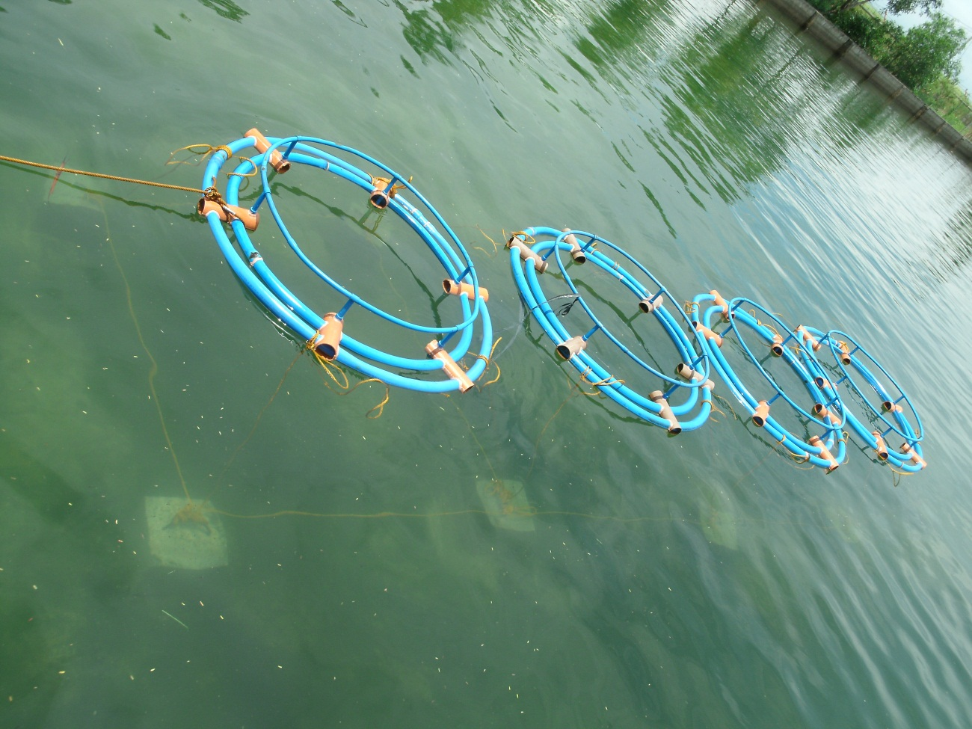
Scale Model Set-up
Mooring Scale Model

Slide 12
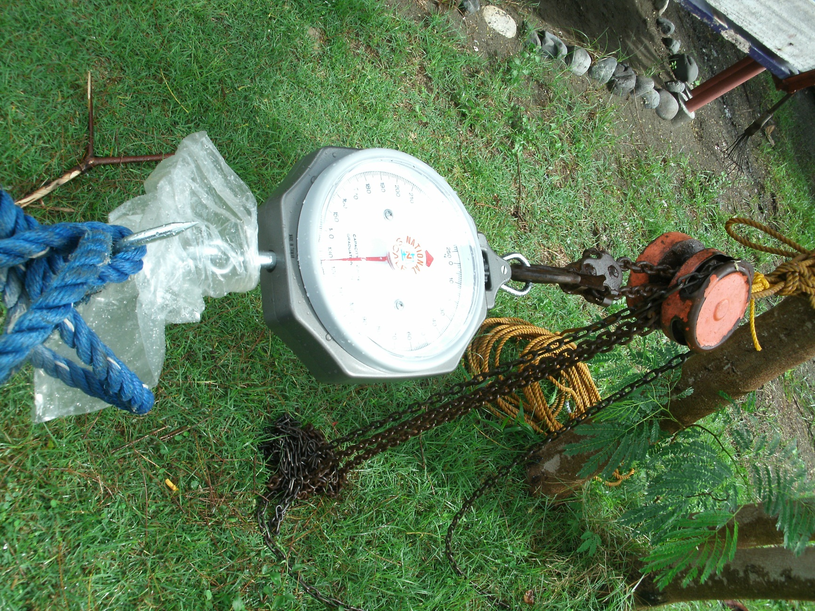
Mooring Scale Model

Slide 13
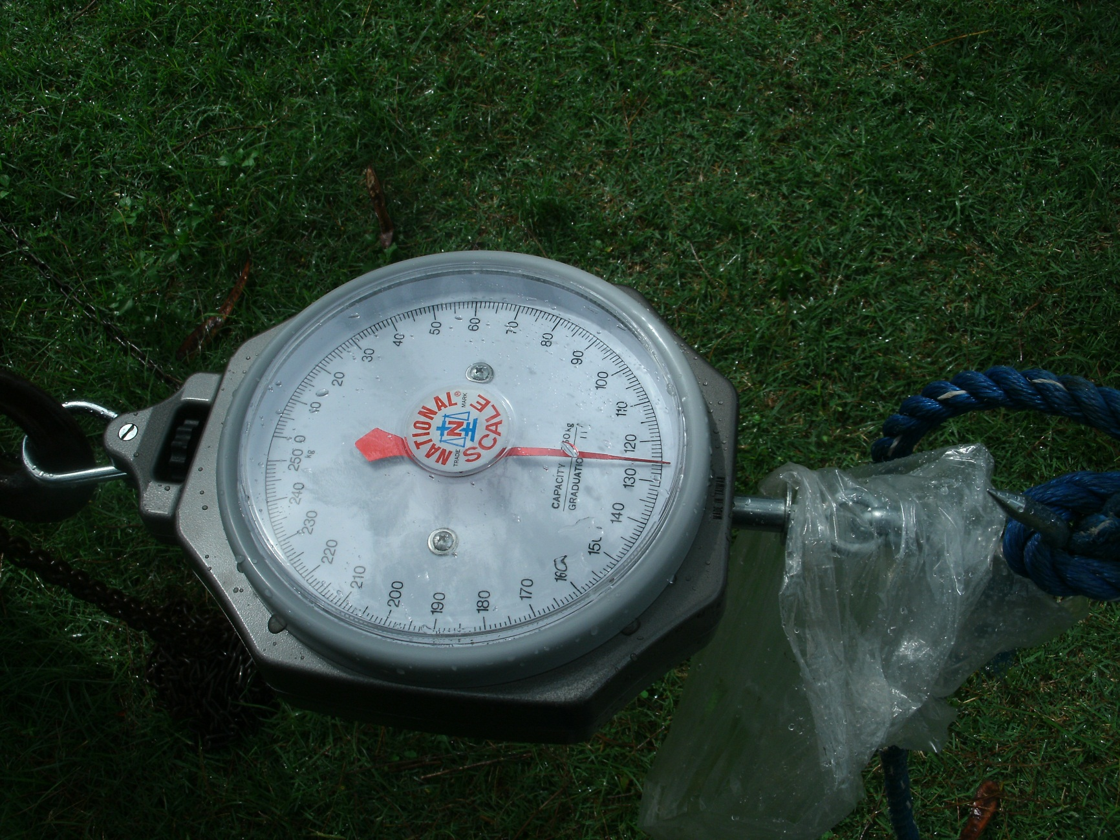
Mooring Scale Model

Slide 14
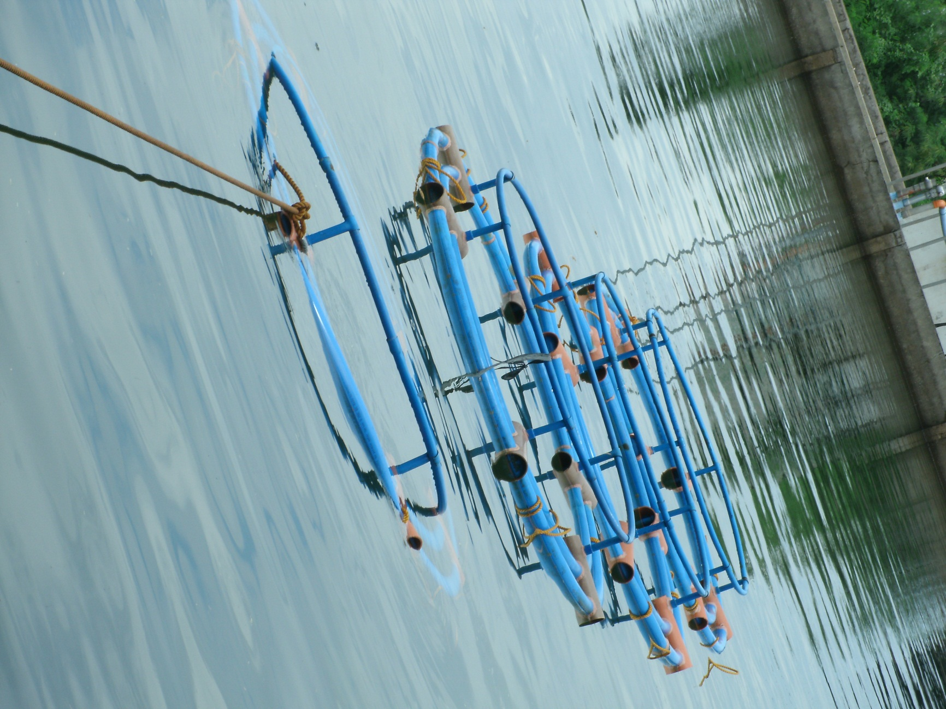
Mooring Scale Model

Slide 15
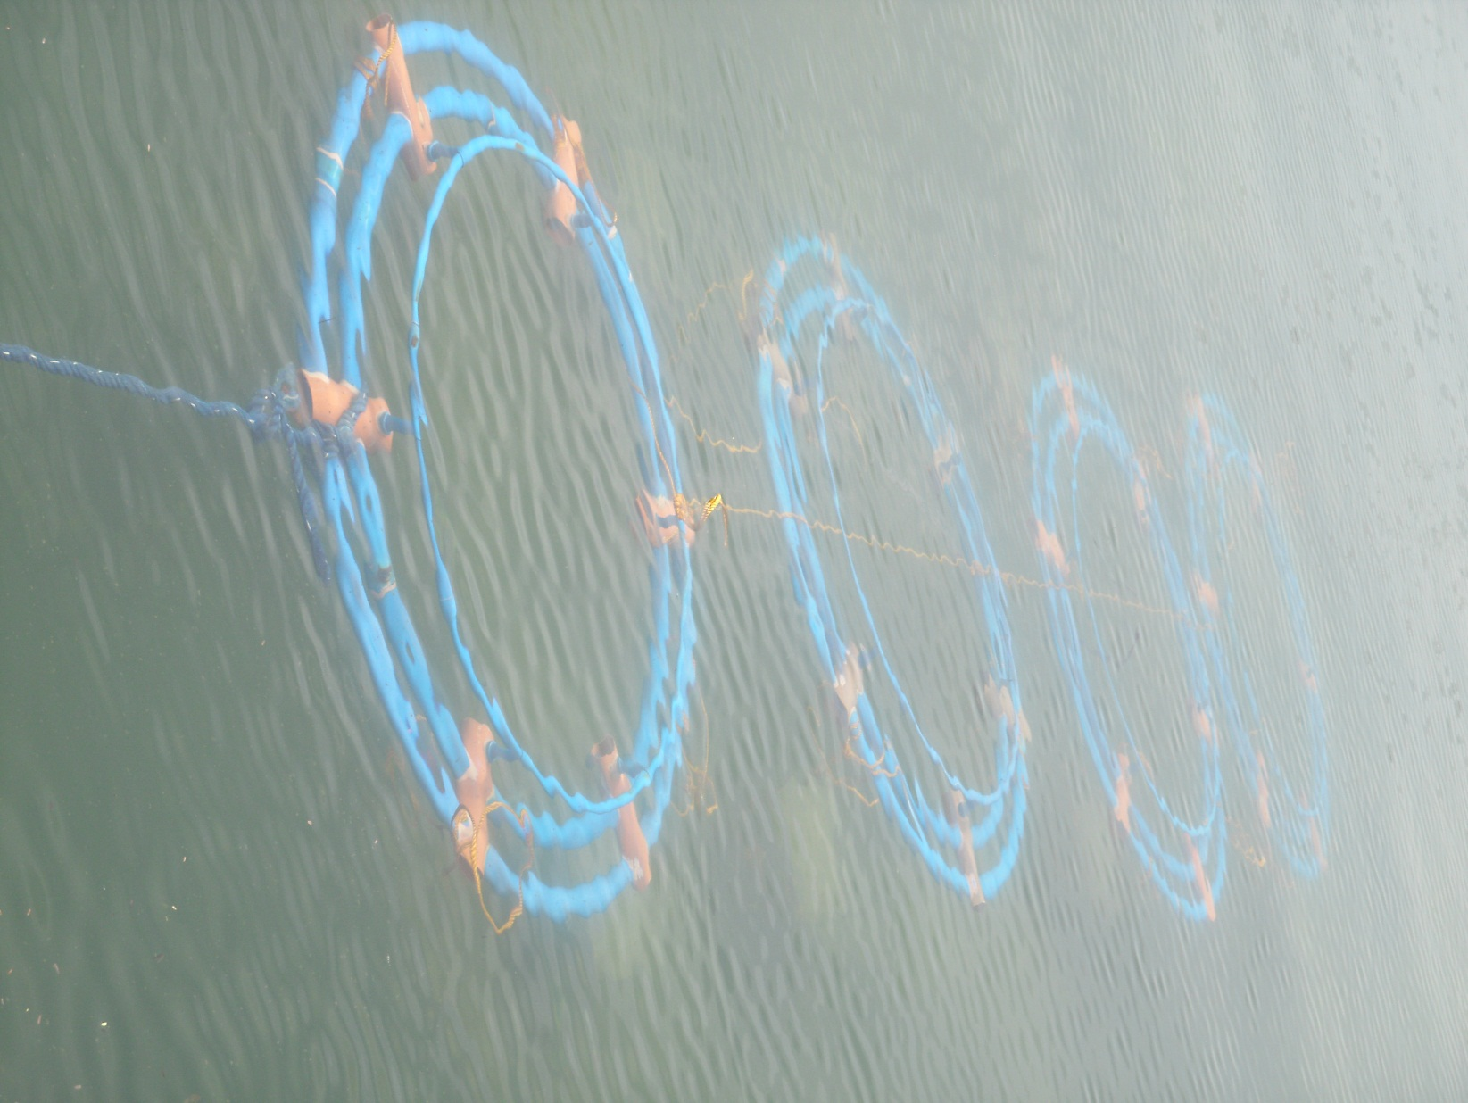
Mooring Scale Model

Slide 16
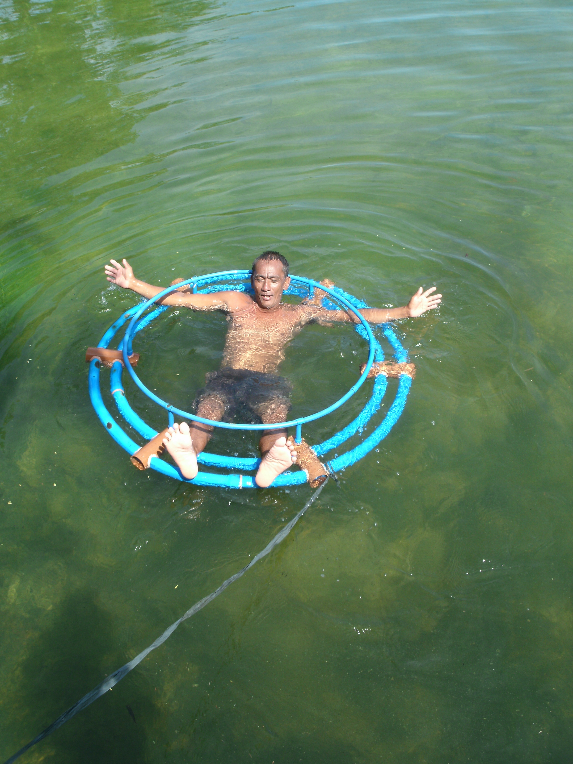
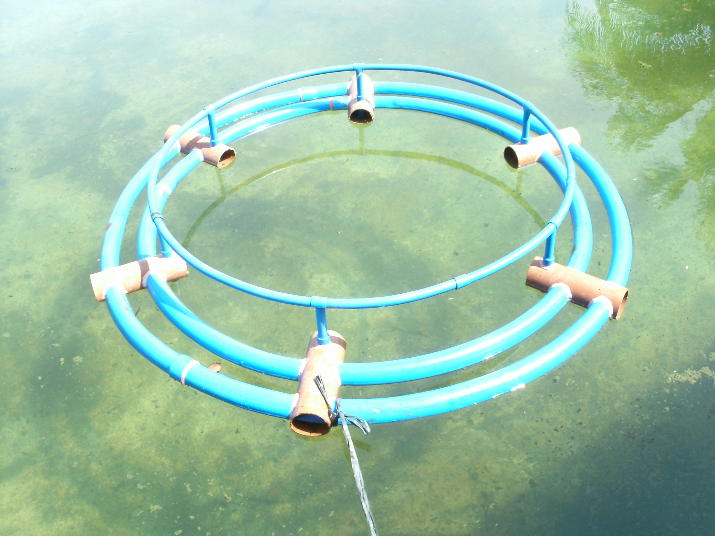
Improved moorings

Slide 17
Results – oil spill contingency
This working report attempts to summarise the measures that Mariculture parks can take to be prepared to deal with oil spills.
The reports summarises
Biological impacts of spills on fish, shellfish and sensitive environments
Oil spill contingency planning and response
Cleanup
Compensation.

Slide 18
Results – Better Management Practices
Draft BMPs which follow the culture process as follows
Crosscutting issues
1. Planning and siting
2. Farm design and construction
Fry and Fingerling purchase or collection
Nursery production
4 Production management
5 Fish health
6 Fish quality and food safety
7 Harvest and post harvest management
8 Monitoring and record keeping
9 Social (staff training, health and safety)
10 Environmental management
11 Dive Operation in Marine Farms

Slide 19
Socio-economic survey
Undertook socio-economic analysis (positive & negative) either perceived or verifiable impacts of implementing Mariculture Parks for
farmer-beneficiaries,
Upstream and downstream stakeholders and
Local communities and LGUs.

Slide 20
SOCIOECONOMIC FRAMEWORK - ADVANTAGES & BENEFITS
UPSTREAM OPPORTUNITIES /ACTIVITIES:
Feeds Suppliers; Fry / Fingerlings Suppliers
Development of Fish Hatcheries/Fish Nurseries
Sellers/Suppliers of Bamboos, Nets, Ropes, Twines , boat makers
Create employment (support staff)
MARICULTURE
PARK
EFFECTS / DIRECT BENEFITS :
Create employment opportunities
to local communities; Livelihoods
Incremental change of income for
marginal fishing families – as
caretakers, harvesters, cage
makers, feeders, cage repairers,
security guards, net washers, etc.
ADDITIONAL REVENUE TO LGUs
(permitting, licensing system)
DOWNSTREAM OPPORTUNITIES/ ACTIVITIES:
Fish Traders, Fish Vendors
Fish Processors; Ice Sellers
Transport rentals
Marketing channels and locations
PERIPHERAL EFFECTS / INDIRECT BENEFITS:
Establishments of General Merchandise (sari-
sari) Stores; Bakeshops
Establishments of coffee shops, restaurants, etc.

Slide 21
Economic survey
Investigate the economics and economic benefits of mariculture parks for the different types of locators and for the local Government/BFAR MP development, technical and infrastructure support in case study areas.
Assess and compare the economic influence of MPs in the case study locations and the comparative regional differences for input costs and market prices

Slide 22
Economic survey
The key components of this investigation are to assess the economics of:
Different aquacultural farming systems in the MPs;
LGU and BFAR support for setting up and providing support of the MP
Differences in regional input cost comparisons,
Cost/benefit and breakeven analysis for support infrastructure
Local and regional market analysis comparisons.

Slide 23

LOCAL GOVERNMENT UNITS
Investment on infrastructure (e.g. roads, markets, etc,
Investment on services
Power supply, etc.
GOVERNMENT AGENCIES
BFAR, DAR, DENR, etc.)
Technical services
Legal services
Manpower development
PRIVATE SECTOR
Feed companies
Fish seed production
Laboratory services (fish disease lab, analytical lab, etc.)
٭ How can these infrastructures and services improve the life of the stakeholders?
Are these investments economically viable?

Slide 24
Criteria | Less than 10 Cages | 10-20 cages | More than 20 Cages
Average Fixed Expenses (% of sales) | 24% | 17% | 17%
Average Variable Expenses (% of sales) | 50% | 26% | 29%
Average Other Operating Expenses (% sales) | 6% | 14% | 5%
Recovery from Depreciation | (4%) | (3%) | (2%)
Average Net Profit (% of sales) | 24% | 46% | 51%
Average Net Profit Per cage (Php) | 185,741 | 230,507 | 287,776
Average Return on Investment | 72% | 117% | 112%
Table 1. Results of Financial Analysis in PCMP

Slide 25
Mariculture park optimisation
Started work on trying to optimise Sual production
Chris Cromey presentation

Slide 26
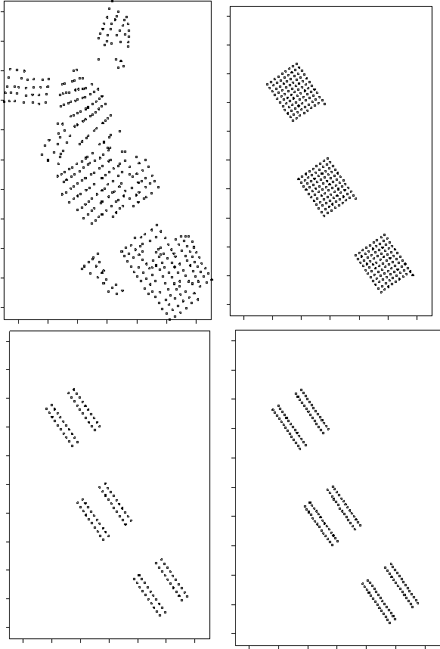
TROPOMOD cage layouts
Scenario B1 – AquaPark scenario
Three 10 ha areas
100 cages per 10 ha
No space in the middle of the zone
Scenario A3 – existing cage layout
Scenario B2 – AquaPark scenario
Three 10 ha areas
40 cages per 10 ha
100 m space in middle of blocks to allow flushing
Scenario B3 – AquaPark scenario
Three 10 ha areas
56 cages per 10 ha
100 m space in middle of blocks to allow flushing

Slide 27
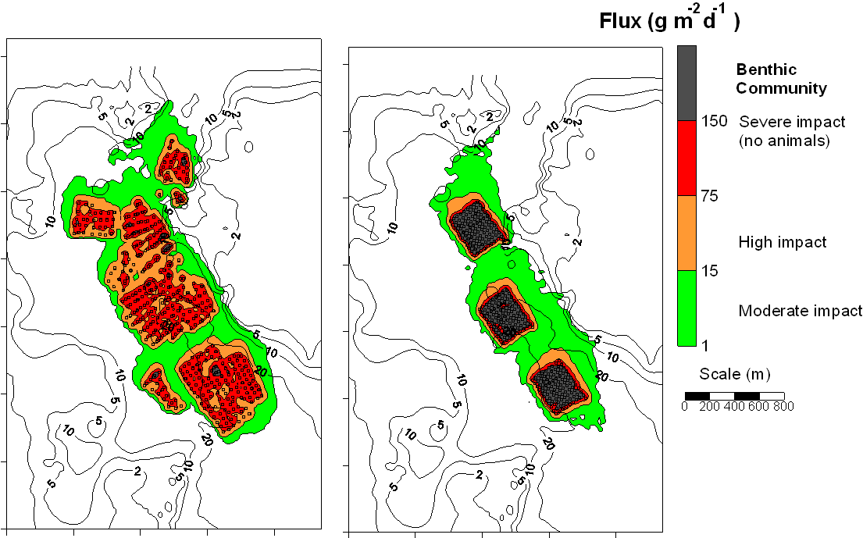
Scenario A3 – existing situation at Sual
Scenario B1 – AquaPark – three 10 Ha areas with 100 cages (11 rows by 9 columns) in each
Impact is very severe under cages and predicted to be worse than existing situation

Slide 28
To attempt to improve on the severe predicted impact in scenario B1, we maintain the 30 ha areas and reduce the numbers of cages in each area.
 | Existing area to the SE | Proposed | Proposed | Proposed (with careful feeding)
Area | 26.7 hectares | 30 ha | 30 ha | 30 ha
Number of cages | 122 | 300 | 120 | 168
Area per cage | 2188 m² | 1000 m² | 2500 m² | 1786 m²
TROPOMOD scenario | A3 | B1 | B2 | B3

Slide 29
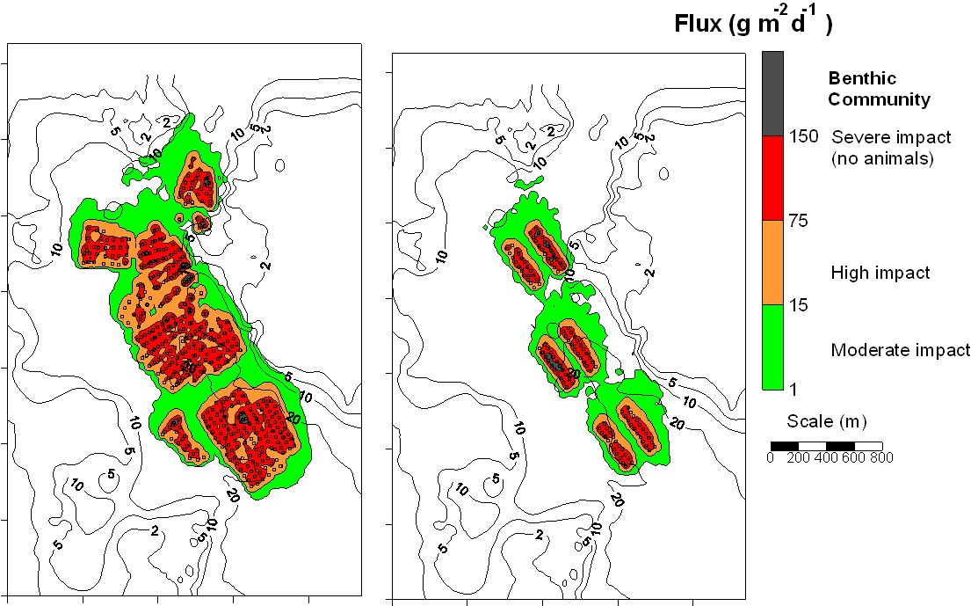
Scenario A3 – existing situation at Sual
Scenario B2 – AquaPark – three 10 Ha areas with 40 cages each (2 blocks of 20 cages)
Predicted impact is much improved, with lanes between the blocks of cages where predicted impact is lower.

Slide 30
To attempt to improve on the predicted impact in scenario B1, we examine the husbandry practices.
In the model, we waste less feed, use a higher quality feed with better digestibility. This means we can also feed less.
As husbandry practices are better, we can increase the number of cages in the three 10 ha areas from 40 per area to 56 cages.
 | Existing area to the SE | Proposed | Proposed | Proposed (with careful feeding)
Area | 26.7 hectares | 30 ha | 30 ha | 30 ha
Number of cages | 122 | 300 | 120 | 168
Area per cage | 2188 m² | 1000 m² | 2500 m² | 1786 m²
TROPOMOD scenario | A3 | B1 | B2 | B3

Slide 31
TROPOMOD model input data – scenarios of husbandry practices
Husbandry data obtained from production surveys at Sual used in the scenarios.
Model input data | Scenario B2 Poor feeding Low digest. | Scenario B3 Careful feeding Better digestibility Less feed needed
Feed wasted | 27% | 10%
Feed digestibility | 49% | 56%
Empty Starter Grower Finisher | Feed input 0 kg/cage/d (5 % cages) 159 kg/cage/d (23 % cages) 337 kg/cage/d (23 % cages) 526 kg/cage/d (49 % cages) | Feed input 0 kg/cage/d (5 % cages) 114 kg/cage/d (23 % cages) 241 kg/cage/d (23 % cages) 376 kg/cage/d (49 % cages)
All cages – circular 20 m diameter by 12 m depth with Milkfish

Slide 32
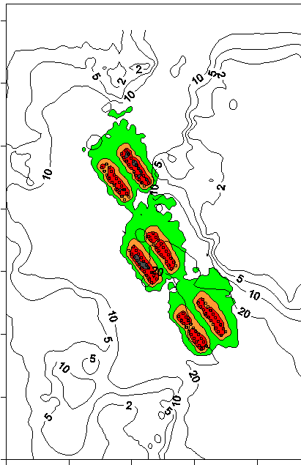
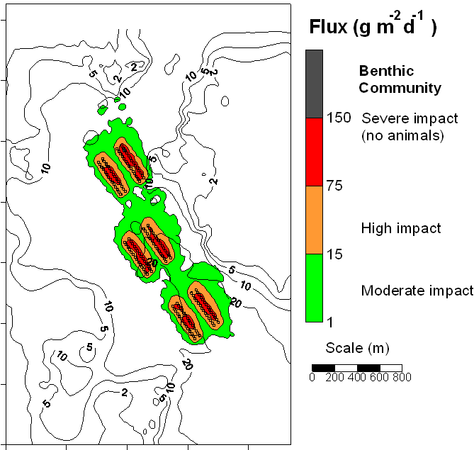
Scenario B2 – AquaPark – three 10 Ha areas with 40 cages each (2 blocks of 20 cages)
Scenario B3 – AquaPark – three 10 Ha areas with 56 cages each.
By improving husbandry, an additional 16 cages could be included per 10 ha

Slide 33
TROPOMOD model – summary of scenarios
 | Scenario B1 | Scenario B2 | Scenario B3 (improved husbandry)
No of cages per 10 ha | 100 | 40 | 56
Biomass per cage (tonnes) | 34 | 34 | 34
Biomass per 10 ha (tonnes) | 3400 | 1360 | 1904
Average stocking density = 8.9 kg m⁻³
Target FCR (wet weight) = 2.2
Specific Feeding Rate (SFR) = 1.6 (scenarios B1 and B2) and 1.2 (scenario B3)

Slide 34
Integration of IMTA
Developing Integrated Multitrophic Aquaculture practice into Mariculture Parks

Slide 35
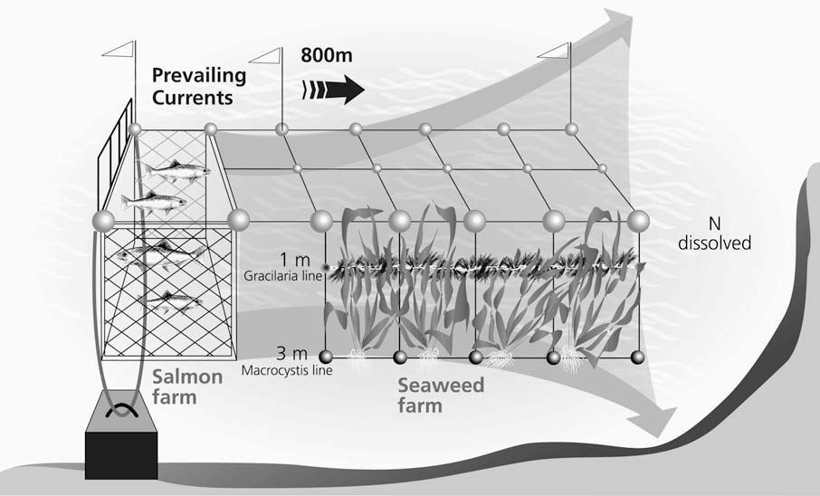

Slide 36
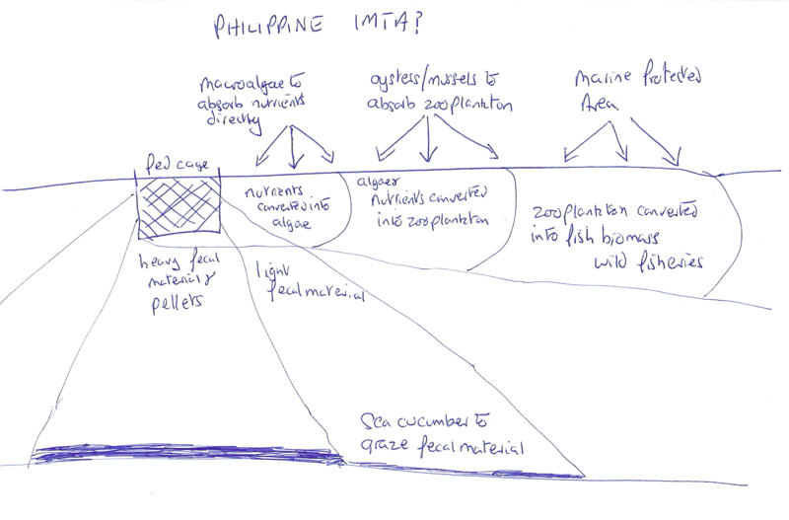
Concept for IMTA in Mariculture Parks

Slide 37

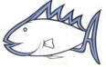

IMTA scenario 2 (Panabo) – wastes from cages reaching suspended culture
% of waste feed and faeces intersecting suspended culture
7% 15% 22% 25%
20% 17% 12% 7%
Suspended
culture
Sediment
25 m 10 m 5 m 3m 0 m 0 m 3m 5m 10 m 25m
Distance from cage edge (m)
Further away from the cages (25 m), particles have settled out and do not reach the suspended culture

Slide 38
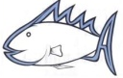
IMTA scenario 2 (Panabo)
(view from above)
North
7%
12%
17%
20%
Percentage of waste feed and faeces reaching suspended culture
4% 10% 16% 20%
13% 9% 5% 1%
25%
22%
15%
7%
For Panabo, residual current to the south means predictions are higher at the IMTA units to the south, and lower to the east
Distance from cages
3m 5m 10m 25m

Slide 39
IMTA scenario 2 (Panabo) – wastes from cages reaching suspended culture at different depths
% of waste feed and faeces intersecting suspended culture
1% 4% 11% 16%
13% 9% 5% 1%
0-3m
3-6m
6-9m
9-12m
12-15m
2% 5% 8% 8%
7% 6% 6% 2%
2% 2% 3% 2%
2% 2% 2% 2%
1% 1% 2% 2%
1% 1% 1% 1%
1% 1% 1% 1%
1% 1% 1% 1%
25 m 10 m 5 m 3m 0 m 0 m 3m 5m 10 m 25m
Distance from cage edge (m)
The majority of the wastes intersect the suspended culture in the top 6 m; these wastes are mostly fine and slow settling Milkfish faeces
Net depth is important when considering optimum depth of suspended culture

Slide 40

IMTA scenario 3 (Panabo) – plume from cages reaching seaweed culture at different depths
% of plume intersecting seaweed culture to the EAST of the cages
Plan view
0-3m
3-6m
6-9m
9-12m
12-15m
19% 14% 8% 3%
N
2% 2% <1% <1%
<1% <1% <1% <1%
<1% <1% <1% <1%
<1% <1% <1% <1%
0m 3m 5m 10m 25m
Distance from cage edge (m)
The majority of the plume containing dissolved nutrients intersects the seaweed culture in the top 3 m.
Net depth is important when considering optimum depth of seaweed culture

Slide 41
IMTA scenario 3 (Panabo) – plume from cages reaching seaweed culture at different depths
% of plume intersecting seaweed culture to the SOUTH of the cages
0-3m
3-6m
6-9m
9-12m
12-15m
Plan view
N
9% 18% 26% 32%
2% 3% 3% 3%
<1% <1% <1% <1%
<1% <1%<1% <1%
<1% <1% <1% <1%
25 m 10 m 5 m 3m 0 m
Distance from cage edge (m)
More of the plume intersects seaweed culture to the south of the cages as this is the direction of the residual current
Net depth is important when considering optimum depth of seaweed culture

Slide 42
IMTA scenario 3 (Panabo) – plume from a large polar circle cage reaching seaweed culture at different depths
% of plume intersecting seaweed culture to the SOUTH of the cages
0-3m
3-6m
6-9m
9-12m
12-15m
Plan view
6% 10% 11% 12%
N
6% 10% 12% 12%
5% 7% 9% 10%
1% 1% 2% 1%
<1% <1% <1% <1%
25 m 10 m 5 m 3m 0 m
Distance from cage edge (m)
A deeper net means more of the suspended line comes into contact with the plume
Seaweed culture at depth will be limited by light rather than nutrients

Slide 43
IMTA scenario 1 – benthic structures
TROPOMOD predictions of the waste feed and faeces depositing on 8 m by 8 m structures on the sea bed
Structures for benthic culture

Slide 44
North
IMTA scenario 1 (Panabo)
(view from above)
Benthic structures
<1%
1%
3%
Percentage of waste feed and faeces reaching bethic structures
4 %
2% <1% <1%
0% <1% 4%
For structures on the sea bed, around 20% of wastes deposited within 8 m of the cages
Fine, slow settling Milkfish faeces are dispersed away from these structures
4%
<1%
<1%
Distance from cages
3m 11m 19m

Slide 45
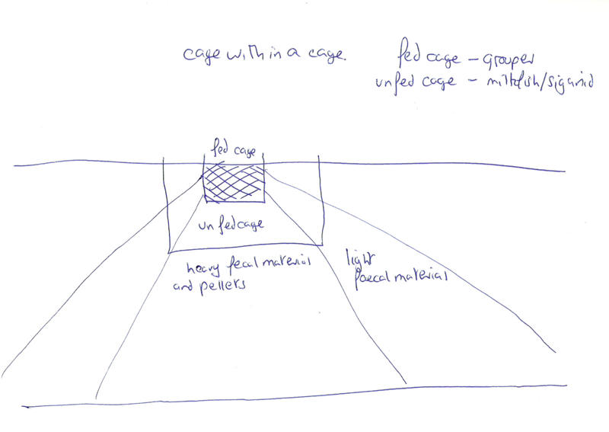
Concept of cage within a cage production

Slide 46
IMTA 4 – cage in a cage
Grouper are in the inner cage, Milkfish in the outer cage
Clean outer nets are essential
Assumptions – all units are dry mass except the ration
100 units wet feed
3 feed
11 faeces
1 faeces
7 faeces
1 feed
Grouper: wasted feed – 12%, digestibility – 49 %, wet FCR 7.5
Milkfish: consumes 70 % of waste feed, 30 % of waste faeces

